Slide 1
HOSPITAL MANAGEMENT SYSTEM
(H M S)

Slide 2
GROUP MEMBERS
OMEXIE CHAMA
CHARLES CHIDULE
JOSEPH VIOLA
MATILDA ISAAC
EDSON MAGOMBO

Slide 3
OUTLINE
Description of Hospital Management System.
Problem Statement
Project Focus
What are benefits of a hospital management system
System requirements ( functional and non functional)
System and user interactions (UML Diagrams)

Slide 4
SYSTEM DESCRIPTION
The Hospital Management System (HMS) is a web application used for the control of hospital services.
The Systems is a customizable, comprehensive, and integrated Hospital Management System designed to manage all hospital operations and can be accessed by either mobile or computer browser.
It has parts that make up a hospital with various departments and allows electronic sharing of patient records with other providers, medical applications and manages the overall health of patients such as patients records, lab results, history online and schedule the next appointment.

Slide 5
PROBLEM STATEMENT
The keeping of patient’s information in the files becomes more tiresome when trying to access the information since it requires more time to go through the files to find a specific name and its related information. File keeping requires more space to store and it is easy to loose data through damaging of files and hard to recover.

Slide 6
PROJECT FOCUS
This project aims to build a system that will store hospital information such as patients, doctors, appointments, medical prescription and other important information. It will also allow hospital staff to access the information easily.

Slide 7
BENEFITS OF HOSPITAL MANAGEMENT SYSTEM
Improving the communication and interaction of doctors with their patients.
It reduces expenses of an organization because of less paperwork, improved safety, and reduced duplication of testing.
Allows easy access to patient data to generate various records, including classification based on demography, gender, age, and medical history.
Enhance information integrity by a reduction in transcription errors and duplication of information entries.

Slide 8
Functional requirements
Functional requirements define the function of the device, explaining the actions taken by the system clearly and quantitatively. these requirements define the capabilities of the system, as well as its process or workflow. it also determines the form of input and output desired. Some of the functional requirements of the system are:
1. Registration: the admin is the only user who can register doctors, nurses, receptions, lab assistants, cashiers and pharmacists. the patient can register through the registration module. in addition, the system should allow a receptionist to register new patients into the system.
2. Authentication: the user (patients) should be able to create an account in the system through the registration.
3. Login: the system must enable registered users including all categories of users to log in through the login module, by entering the username and password.
4. Manage account: users of the HMS system should have the ability to manage their account including changing their password, email or phone number.
5. Booking an appointment: the system shall provide the available appointment to receptionist and patients in order to book a new appointment
6. Prescription: the doctor shall user the system to create/enter a prescription for the patient. on the other hand, the patient also should have access to view the prescription through his/her account.
7. Billing: the system shall allow the cashier to create and order invoice for payment through the billing module.

Slide 9
Non-Functional Requirements
The non-functional requirement defines the operational requirements off the system, as well as the constraints to be followed in order to improve the system's functionality. The following are some of the non-functional requirement that needs to be considered in system:
Availability: the system must be available 24/7.
Responsiveness: the system (web application) must be adaptive and responsive to support devices of all types.
Accessibility: the system can be accessed by the admin and many other users but the access level is controlled of each user as per their scope of work.
Safety and maintainability: a backup of the database should be performed every week, so that the system can be recovered in case of any database damage, which may be occurred due to a catastrophic failure
Security:
modification changes in the system like (insert, erase, and update) is coordinated and performed by the admin only.
user rights: users’ activity of the system should be controlled so that each user can access the allowable activities only.
data: the transaction data should be transmitted in an encrypted form.
database protection: the database should be protected by a strong hashed passwords

Slide 10
USER AND SYSTEM INTERACTION DIAGRAMS

Slide 11
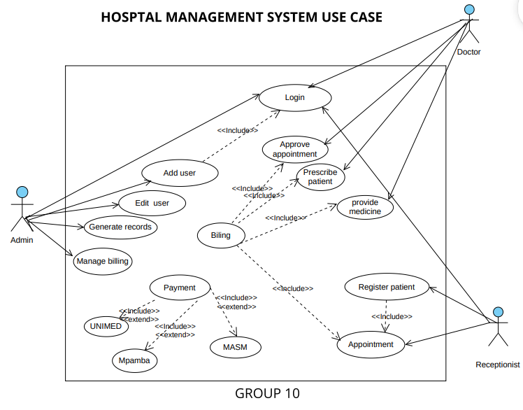
USE CASE

Slide 12
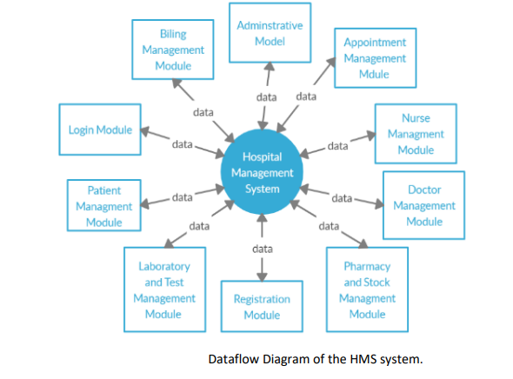
DATA FLOW DIAGRAM

Slide 13
TOOLS USED FOR DESIGNING AND DEVELOPING THE SYSTEM
Figma for system prototype
PHP Language for backend
CSS and HTML
Bootstrap framework
Xampp(MySQL) for Database management

Slide 14
SYSTEM PROTOTYPE
HOSPITAL MANAGEMENT SYSTEM

Slide 15
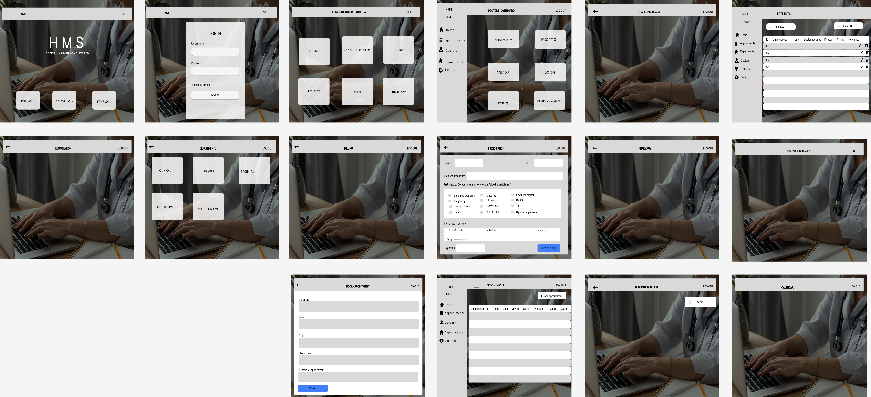

Slide 16
SYSTEM DEMONSTRATION

